Slide 1

Introduction to
SnackBar Widgets in Flutter
By Wilsons Navid

Slide 2
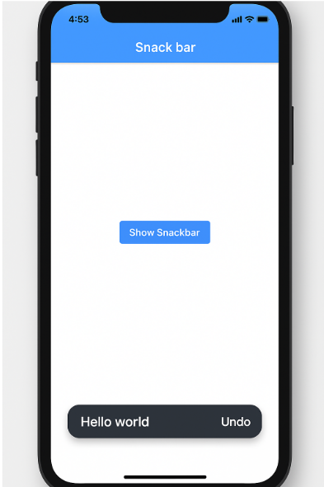
What is a Snackbar?
A Snackbar is a lightweight notification bar which displays messages temporarily at the bottom of the screen. Snackbars auto-dismiss after a few seconds. They can also include optional user actions.

Slide 3

When and Why to Use a Snackbar
Brief Feedback
Use for short app feedback, like form submission or item deletion. It provides confirmation.
Non-Intrusive
Snackbars don't interrupt the user's flow. They appear and disappear without requiring interaction.
Not for Critical Messages
Avoid for critical or persistent information. Use dialogs for actions requiring immediate attention.

Slide 4
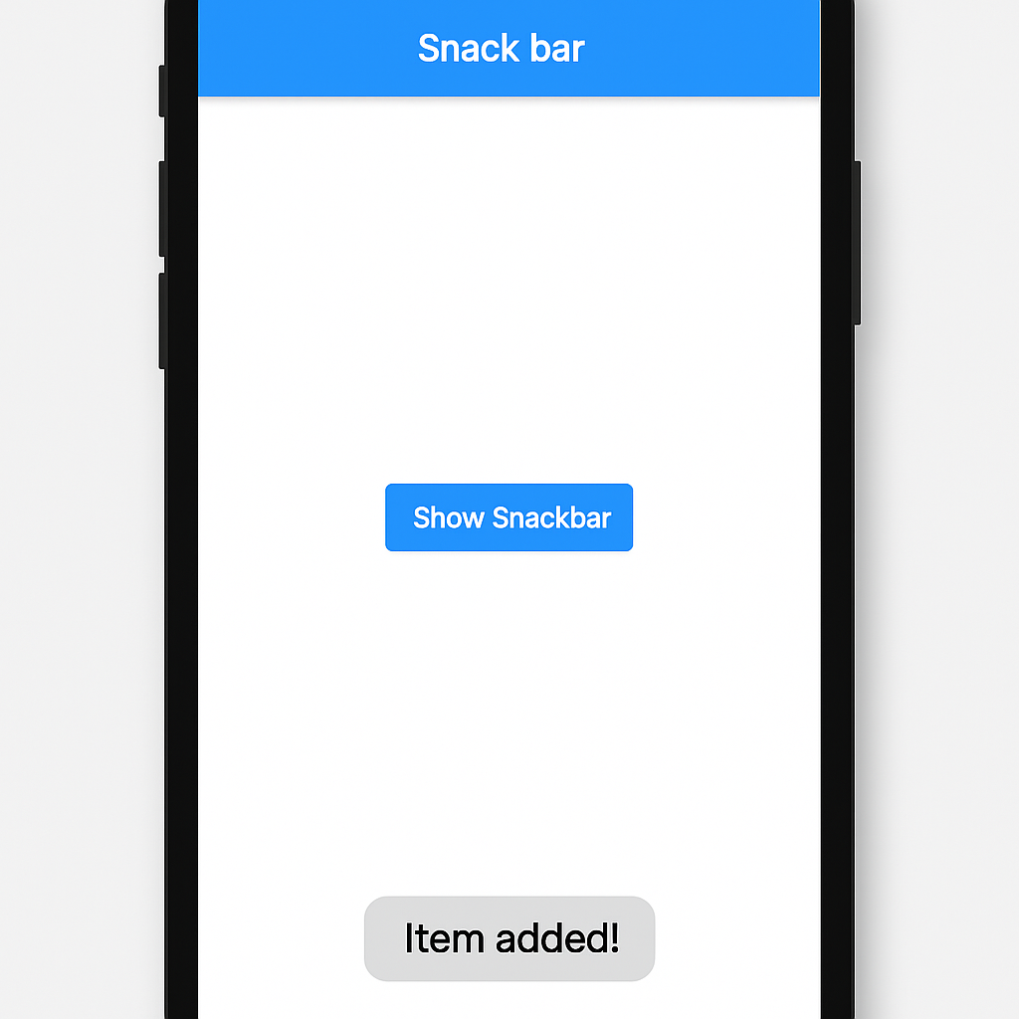
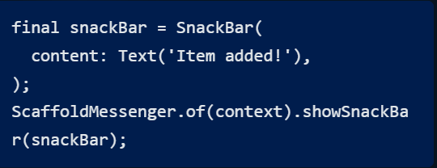
Basic Implementation in Flutter
The SnackBar widget contains the message and the ScaffoldMessenger.of(context).showSnackBar displays it. This simple code creates a basic notification.

Slide 5
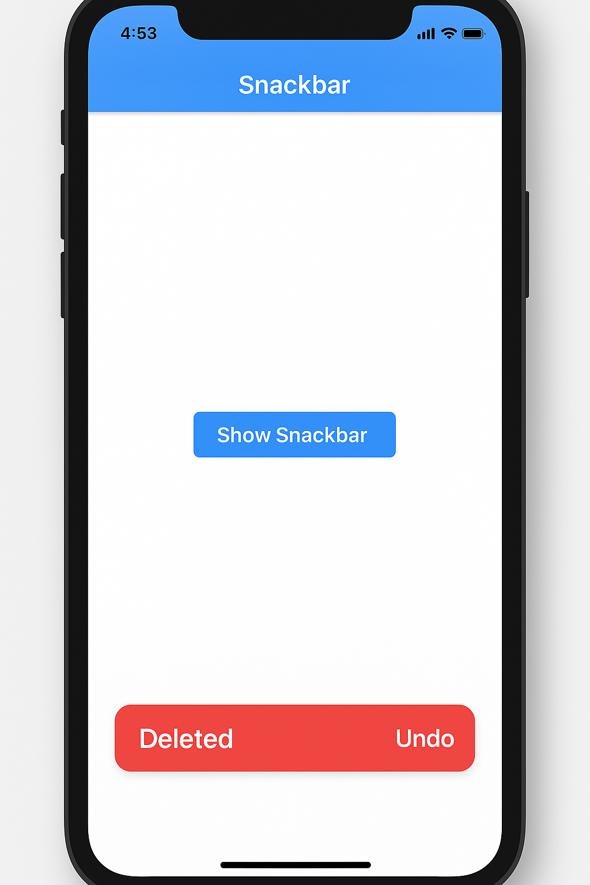
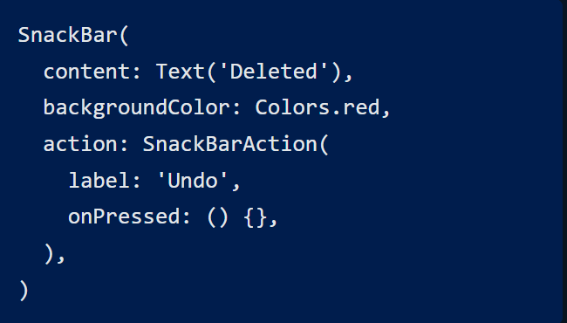
Customizing the Snackbar
Options:
Add action buttons for user interaction.
Set a custom display duration.
Change the background color.
Apply rounded corners or elevation.
These options allow tailoring the Snackbar to your app's design.

Slide 6

Summary & Best Practices
User Feedback
Excellent for providing quick user feedback.
No Critical Info
Do not use for critical confirmations.
Customize Design
Customize appearance when necessary.
Avoid Overload
Don't overload the Snackbar with too much text.

Slide 7

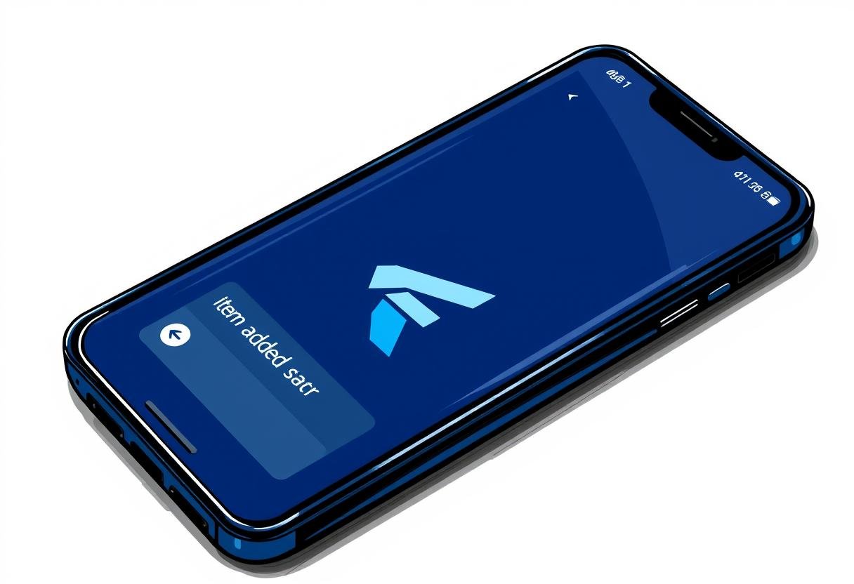
Thank You
Wilsons Navid
w.wadotiwa@alustudent.com

